Slide 1
House Ways & Means
Economic Development
Budget Subcommittee
January 2022

Slide 2
Act 90 Activity
Enacted June 2021
Board Update:
  Peter McCoy confirmed as Chair
  Cooperatives - 2 ex-officio members are seated and active
  Board has selected new CEO – Jimmy Staton
Legislative Oversight: JBRC
  Approved several financing and property transactions
  Received Santee Cooper 2021 Real Property Report
Oversight: Agency Head Salary Commission
  Approved compensation for CEO in 2021
  Approval for new CEO compensation is required
Regulatory Oversight: Office of Regulatory Staff
Regulatory Oversight: Public Service Commission
  Allowable Ex Parte Briefing held Oct. 14
  Allowable Ex Parte Briefing scheduled for Feb. 8

Slide 3
^{Price Stability}
Over a decade of stable or declining prices
Rate Freeze
Industrial rates based on aggregate sales, including non-firm.
___________________________
Notes:
Reform Plan 2030- Res 12.03, Commercial 9.33, Industrial 4.81 - ind and com is mostly due to usage change (com) and less non-firm

Slide 4
Preliminary 2021 Financial Results –
Key Financial Metrics
  Days Liquidity on Hand = 355 Days
  Days Cash on Hand = 161 Days
  Debt-to-Equity Ratio = 76/24
  Debt Service Coverage = 1.22x
Positive Bottom Line Results
  Funds Available After Operations & Debt Service = $95 million
  Reinvested Earnings = $52 million

Slide 5
Operational Excellence
Reliability ranks #9 (top 2%) out of over 475 IOU and co-op utilities in the U.S.
Employees achieved best safety year on record in 2021
Success in economic development - In 2021 alone we assisted state and local governments, co-ops and others to help attract a projected $1.4 billion in capital investment and 2,300 jobs
  New Century contract retained 300 jobs, added ~100 jobs
Lakes Marion and Moultrie support $434 million in annual tourism spending and over 3,600 jobs

Slide 6
Customer Satisfaction Survey 2021 Results
Residential 94.6%
Commercial 96.7%
Industrial 100%
Municipal wholesale 100%
Cooperative Wholesale 7.1%

Slide 7
Water Systems
Lake Moultrie
  Serves parts of Berkeley, Goose Creek, Moncks Corner and Summerville
  >200,000 consumers, growing
  40 million gallons per day (MGD) capacity, 20 miles of pipeline
Lake Marion
  Will ultimately serve parts of Berkeley, Calhoun, Dorchester and Orangeburg and Town of Santee
  8.5 MGD, 3,000 users and aggressively growing
  Winding Woods Reach dedication Jan. 25, 2022
  5-Year-Plan includes 7 new reaches and two tanks

Slide 8
Improving DE&I
IDEA Council
  Employee programs and recognition
  Supplier Diversity Initiative
    Partner with Carolinas-Virginia Minority Supplier Development Council
    Improve our supplier pool
    Help suppliers get minority/women-owned designation
Community Support and Engagement
  Denmark Tech lineworker training
  SC State: Limnology Center support, EPRI program
  Optus Bank investment
  Middle-mile broadband program
8

Slide 9
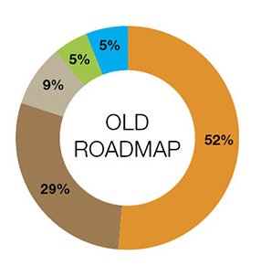
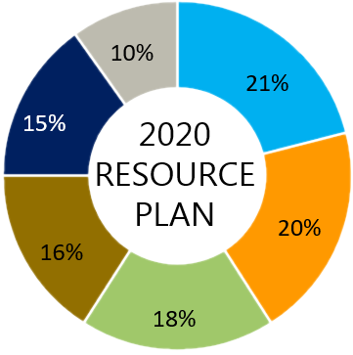
Projected 2030 System Fuel Mix¹
Santee Cooper’s future power supply will be comprised of more solar, less coal, and 55% fewer emissions
Significantly improves fuel diversity
Source: Santee Cooper 2020 Integrated Resource Plan
The projected energy mix includes recently executed solar contracts including Central’s load ratio share. Central is a direct PPA counterparty for its load ratio share, however, all solar resources are pooled and managed with other combined system resources.
Notes:
Slide 17 – 2030 System Mix, Rahul Dembla
As you can see from our most recent 2020 Resource Plan, in 2030 Santee Cooper significantly improves fuel diversity and flexibility. Our future power supply is comprised of more solar, less coal and 55% fewer emissions.

Slide 10
1% Payment To The State
2022 = $18.4 million budgeted
2021 = $17.1 million
Cumulative PTS = $462 million
Notes:
Cumulative PTS reflects payments made from 1948 through 2019

